Slide 1
CONCEPT OF DEMAND
NAPINDER KAUR
Assistant Professor

Slide 2

WHAT’S IN THE NEWS?

Slide 3
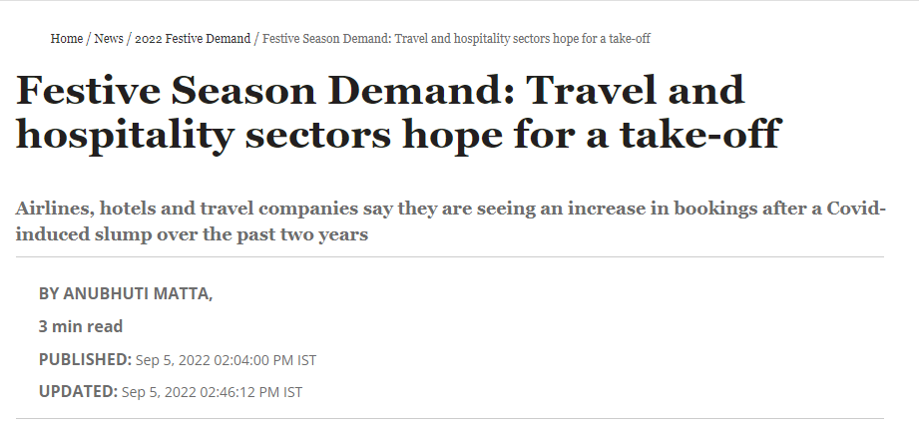
NEWS

Slide 4
LEARNING OUTCOMES
After the lecture, you will be able to
understand the basics of demand
The relevance in economic decision making.

Slide 5
MARKET
Interaction of buyers and sellers of a good (or a service) at a mutually agreed price.

Slide 6
DEMAND
Demand is quantity of a commodity which consumers are willing to buy at given price for a particular unit of time.
Effective desire

Slide 7
TYPES OF DEMAND
Direct and derived demand
Recurring and replacement demand
Complementary and competing demand
Demand for consumer goods and capital goods
Demand for perishable goods and durable goods
Individual and market demand

Slide 8
RAKE YOUR BRAIN
Which of the following is true for capital goods?
They are demanded for their own sake.
They are demanded by final consumers.
Their demand is direct.
Their demand is derived.

Slide 9
DETERMINANTS OF DEMAND
Price of the product
Income of the consumer
Price of related goods
Tastes and preferences
Advertisement
Consumer’s expectation of future income and price
Population
Growth of the economy
Consumer credit

